Slide 1
The Brunometer
A Habitable Zone Reckoner
Notes:
Region of space where stellar conditions are favourable for life as it is found on Earth.

Slide 2
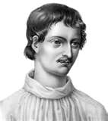
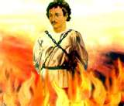
Giordano Bruno
Italian philosopher
Advocate of heliocentrism and the infinity of the universe
“In space there are countless constellations, suns and planets; we see only the suns because they give light; the planets remain invisible, for they are small and dark. There are also numberless earths circling around their suns, no worse and no less than this globe of ours. For no reasonable mind can assume that heavenly bodies that may be far more magnificent than ours would not bear upon them creatures similar or even superior to those upon our human earth.”
In 1600 AD Bruno was burned at the stake in Rome as a heretic by the Roman Inquisition!
Word of warning to anyone who finds themselves transported back to the 17th century

Slide 3
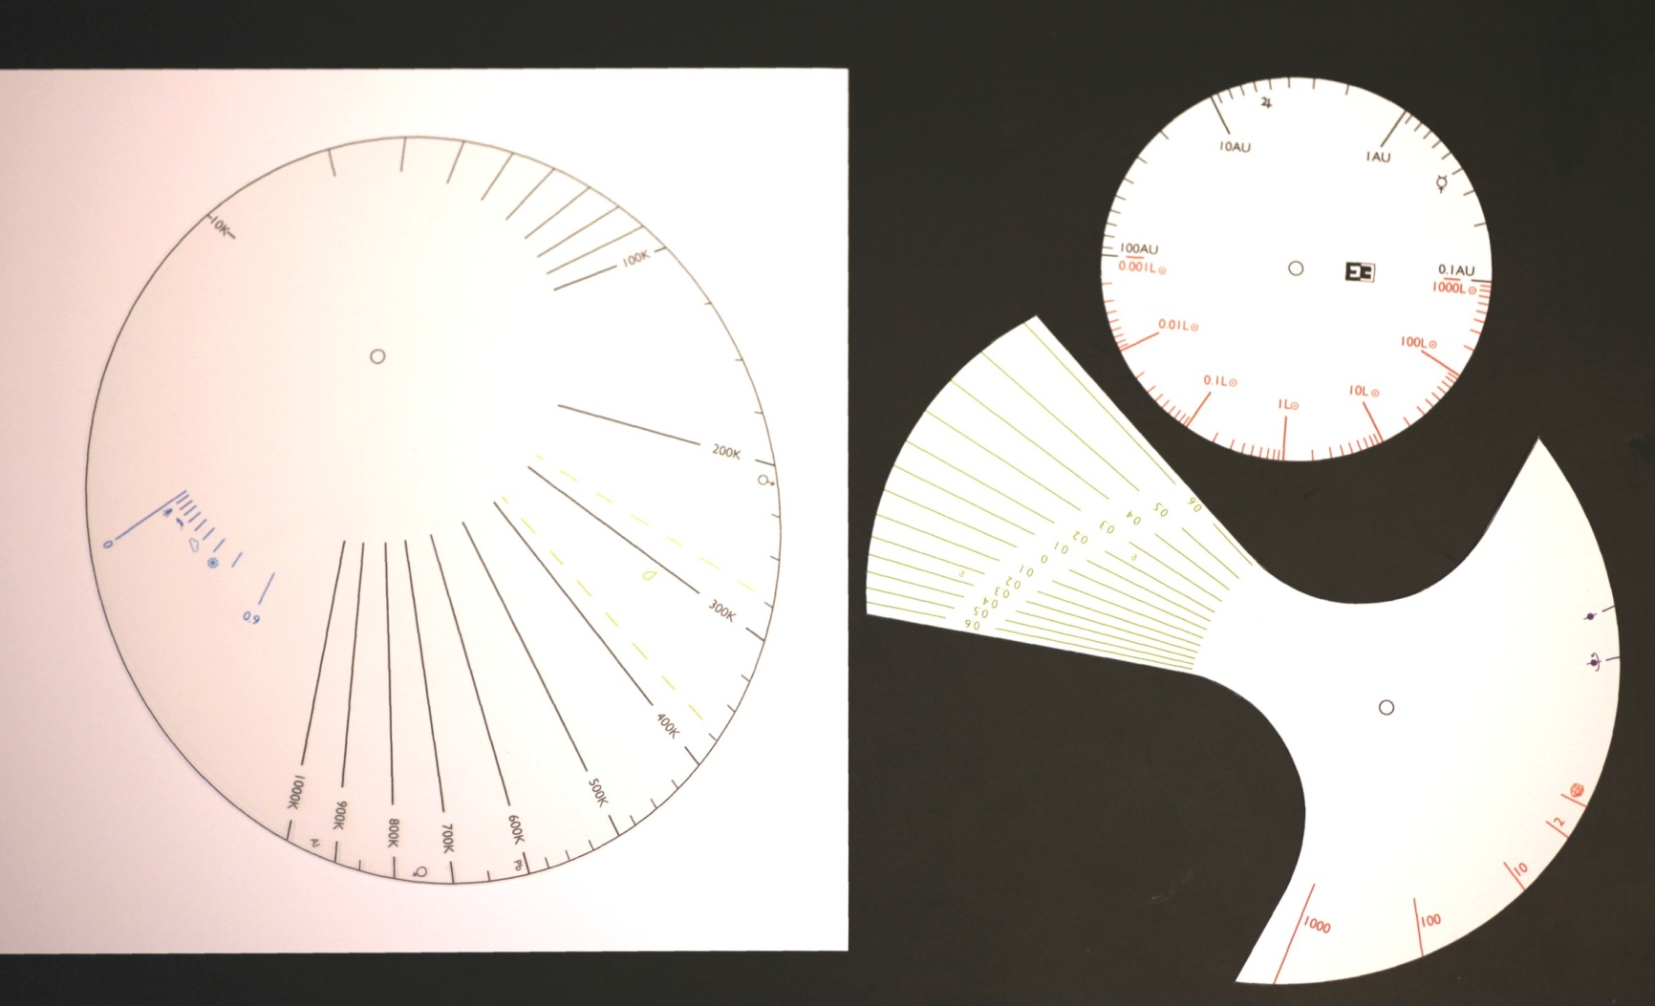

Slide 4
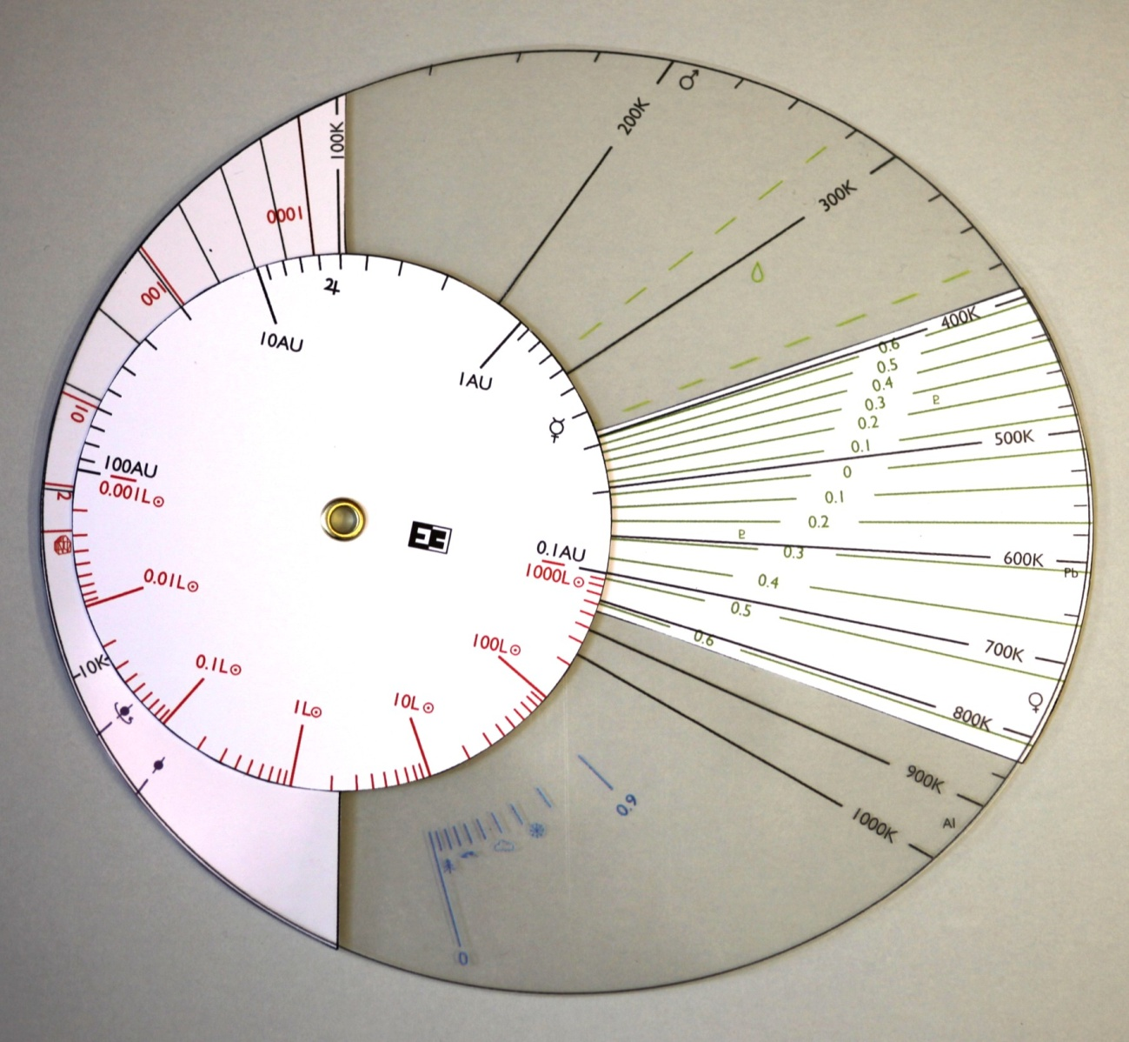

Slide 5
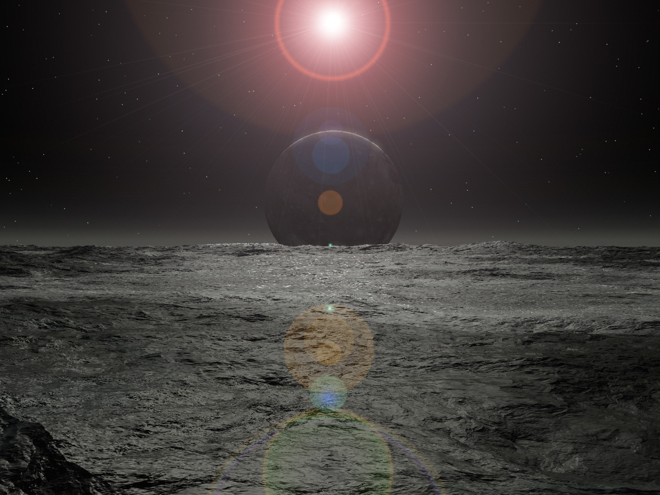
The temperature of rocky planet depends on several factors
Brightness of star (3.8x10²⁸ W)
Distance between planet and star and how this varies with time
Whether the planet is spinning or not
The thickness of the atmosphere
The amount of radiation from the star reflected back into space
Image by Jeff Bryant

Slide 6
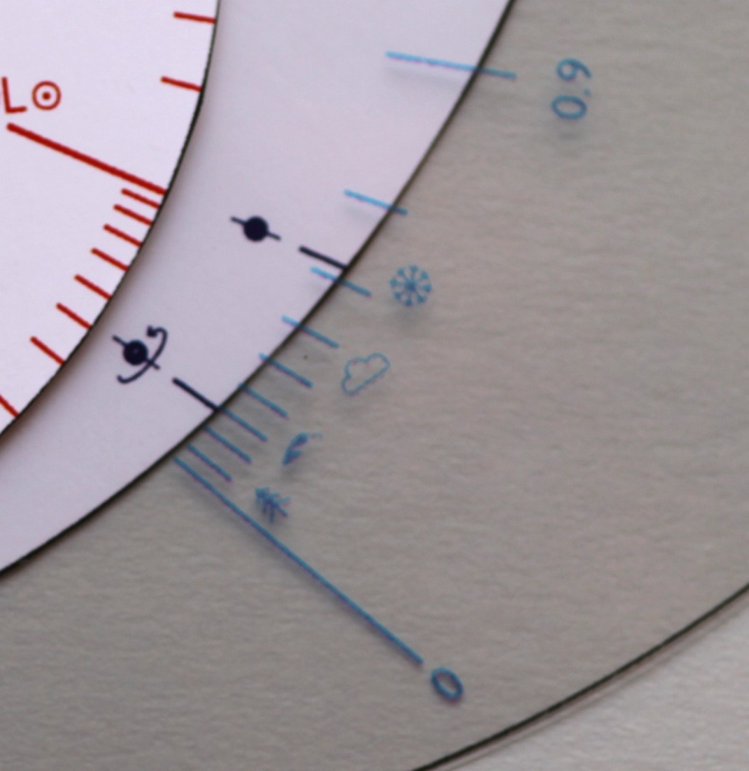
How Much Radiation is Reflected?
The albedo scale
0 = perfect absorber
1 = perfect reflector
Forests ~ 0.1-0.2
Desert ~ 0.3-0.4
Clouds ~ 0.6
Snow ~ 0.7
Is the planet spinning?

Slide 7
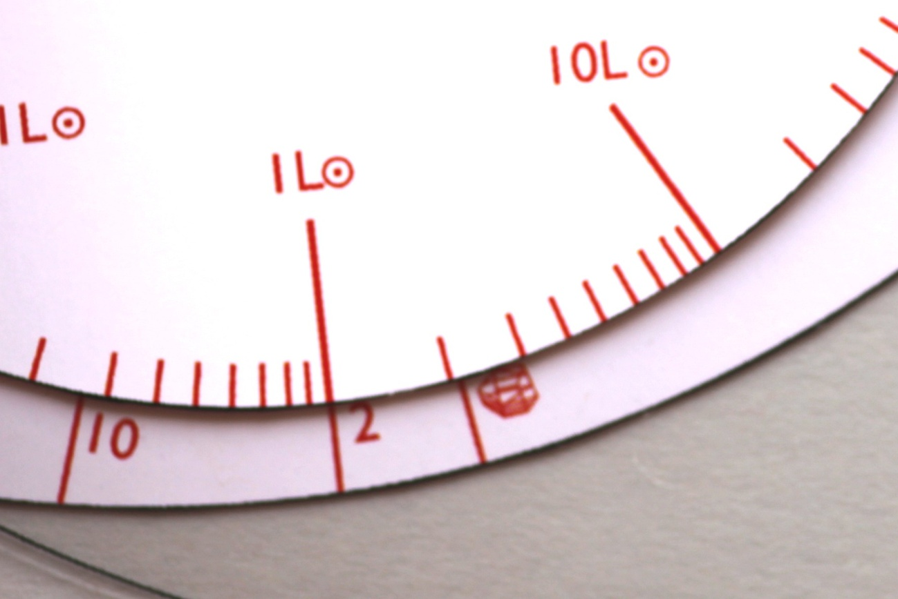
How Bright is the Star?
1 = luminosity of Sun
45 = luminosity of Pollux
0.016 = luminosity of GL 229B
Greenhouse Effect – gives a larger number on the Greenhouse scale
symbol = no atmosphere
Earth (on this scale) ~ 2
Venus (on this scale) ~ 100
How Thick is the Atmosphere?

Slide 8
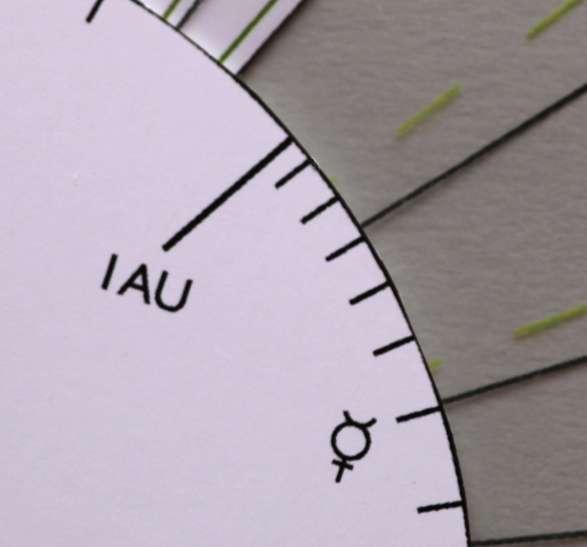
What is the distance from the planet to the star?
1 AU = Earth – Sun distance
Planet | Distance (AU) | Symbol
Mercury | 0.387
Venus | 0.723
Mars | 1.524
Jupiter | 5.203
Saturn | 9.539
Uranus | 19.191
Neptune | 30.061
Pluto | 39.529
Mercury

Slide 9
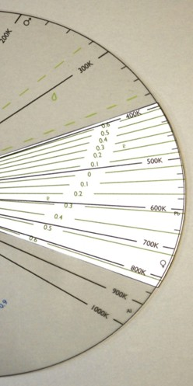
Mean surface temperature of Mars
Liquid water for temperatures between the broken green lines
Aphelion for planet with same eccentricity as Pluto
Perihelion for planet with same eccentricity as Pluto
Melting point of Lead (Pb)
Mean surface temperature of Venus
Melting point of Aluminium (Al)

Slide 10
Temperature of the earth
Use the Brunometer to calculate the surface temperature of the earth if there was no atmosphere
  Remember the albedo is 0.3
How does this compare to the temperature of earth if the atmosphere is no longer neglected?
  Remember the atmospheric thickness is 2
Answer: ~267K
Answer: ~320K
Convection in the earth’s atmosphere reduces the average temperature to ~290K

Slide 11
Eccentricity
Eccentricity (e) describes the shape of an orbit
For a circular orbit: e = 0
For an elliptical orbit: 0 < e < 1
e = 0
Aphelion
Perihelion
e = 0.5

Slide 12
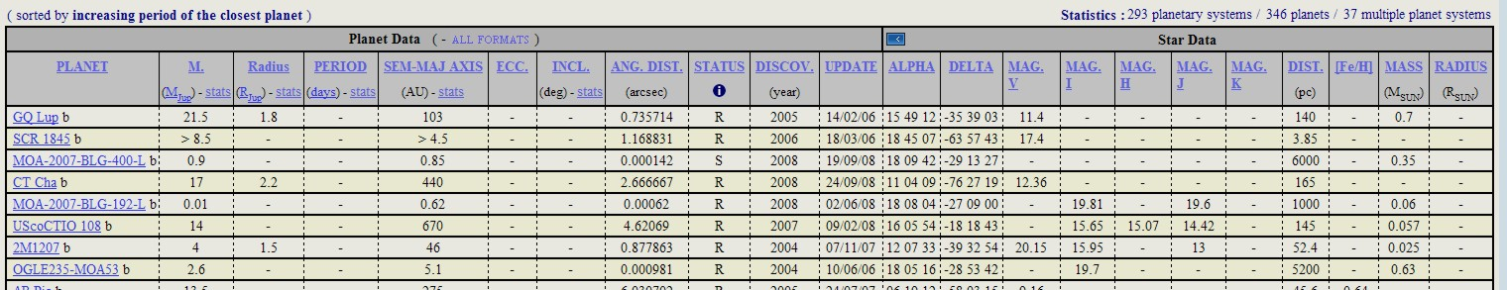
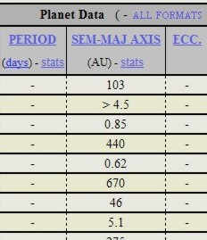
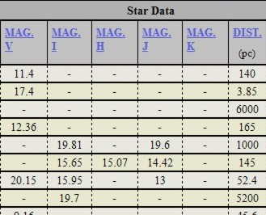
Using the Brunometer with the Extrasolar Planets Encyclopaedia

Slide 13
Finding the Luminosity of a Star from its Magnitude and Distance
Planet Name | Mass (Jupiters) |  | Period | Semi-major axis | Eccentricity |  |  | Star Distance | Spectral type | Star Mass |  | RA | DEC | Visual magnitude
55 Cnc b | 0.824 |  | 14.65162 | 0.115 | 0.014 |  |  | 13.02 | G8 V | 1.03 |  | 08 52 37 | +28 20 02 | 5.95
55 Cnc c | 0.169 |  | 44.3446 | 0.24 | 0.086 |  |  | 13.02 | G8 V | 1.03 |  | 08 52 37 | +28 20 02 | 5.95
55 Cnc d | 3.835 |  | 5218 | 5.77 | 0.025 |  |  | 13.02 | G8 V | 1.03 |  | 08 52 37 | +28 20 02 | 5.95
55 Cnc e | 0.034 |  | 2.81705 | 0.038 | 0.07 |  |  | 13.02 | G8 V | 1.03 |  | 08 52 37 | +28 20 02 | 5.95
55 Cnc f | 0.144 |  | 260 | 0.781 | 0.2 |  |  | 13.02 | G8 V | 1.03 |  | 08 52 37 | +28 20 02 | 5.95
Example:
For 55 Cancri: d = 13.02 parsecs; m_{star} = 5.95
Giving Lstar = 0.59 LSun

Slide 14
Questions
How much more luminous would the sun have to be to heat earth to a high enough temperature to melt Aluminium?
  Remember the earth has an average albedo of 0.3 and an atmospheric thickness of 2
A rotating planet with no atmosphere is orbiting a star at a distance of 1 AU. If the star has 10% the luminosity of the sun, determine the change in effective temperature that the planet will experience if the fraction of incoming radiation that is re-radiated into space (albedo) changes from 10% to 90%.
Answer: 80L
Answer: ~65K

